Slide 1
Advanced Software Engineering CS 6680: Android Application for ESL Lab & Tutor Records
By
Rajith Navab(1506873)
Ganganaboina Ashish Yadav (1484040)
Anh Hoang (1286361)
Computer Science Dept.
Troy University

Slide 2
Contents
Introduction
Software Requirements
System features
Feasibility and Cost estimation
Project Schedule
Models and Diagrams
Demo Application
Notes:
Agile development

Slide 3
Introduction
Purpose
ESL student record is a unique application specifically designed for Troy University’s ESL department. This app will maintain the records of the ESL computer lab and tutoring room.
Brief descriptions
This application will have an admin, who can access the database.
He can add a student or tutor into a program.
Scope of viewing the lab report or the Tutor report which includes all the details of the lab and tutoring room.

Slide 4
Software requirements
Hardware Interface: An android phone or tablet with wi-fi or internet connection.
Software Interfaces: Windows Operating system
Platform: Android Lollipop SDK 5.0
Software: Android Studio
Technologies Used: Java, XML - Database Used: SQ Lite

Slide 5
System Features
View Computer Lab Report
View Tutors Report
Contacts View
Comment
Graph
Print

Slide 6
Feasibility Study
Technology
We used Java programming language for this application and it also has many libraries which are readily available and it supports code re-usability.
Finance
This project is developed for the ESL Department in the university, so head of the department accepted to spend enough budget to complete this project.
Human Resources
We are a team of three members that have experience in java programming, SQL database.
Time
We need to complete the project before the next semester students comes in so that we can add students and faculty in the application before the semester starts.

Slide 7
LOC-Based Estimation
LOC-Based Estimation
Estimation Table
Estimation Table
 | Functions | Lines of code | Estimation
1 | Add Student | 125 | 150
2 | Add Tutor | 151 | 200
3 | Login Function | 239 | 300
4 | Director Page | 283 | 250
5 | Lab Functionality | 301 | 400
6 | Student Page | 255 | 200
7 | Tutoring Functionality | 407 | 500
8 | View Activity | 385 | 300
9 | Report Function | 292 | 300
10 | Database system | 170 | 300
 | Total | 2608 | 2900

Slide 8
Project Estimation
Cost per LOC | $1.40 | /line
Total | $3700.00
Total time for 1 person to do the project | 4.0 | months
Team member | 3 | people
Total time to code for the project as a team | 2.10 | months
Notes:
SLACK
Query database
Database Lab, Tutoring not clear
Why using lab why include lab ,
Class Diagram
Sequence Diagram
Object on top
Write DB Connect
Object coming from class
Make sure design
Final Multiplte slides
ADD the code create database on presentation

Slide 9
Function Point Count
Function Point Base Estimation | Count | Weighing Factor (Simple) | FP Estimate
Number of external inputs (EIs) | 6 | 3 | 18
Number of external outputs (EOs) | 3 | 3 | 9
Number of external inquiries (EQs) | 2 | 4 | 8
Number of internal logical files (ILFs) | 1 | 4 | 4
Number of external interface files (EIFs) | 0 | 5 | 0
Total |  |  | 39
Notes:
inquiries ??? Why need this one??

Slide 10
Complexity Adjustment Table
1 | Does the system require reliable backup and recovery? | 2
2 | Are data communications required? | 4
3 | Are there distributed processing functions? | 3
4 | Is performance critical? | 2
5 | Will the system run in an existing, heavily utilized operational environment? | 2
6 | Does the system require on-line data entry? | 0
7 | Does the on-line data entry require the input transaction to be built over multiple screens or operations? | 3
8 | Are the master files updated on-line? | 1
9 | Are the inputs, outputs, files or inquiries complex? | 1
10 | Is the internal processing complex? | 3
11 | Is the code to be designed reusable? | 1
12 | Are conversion and installation included in the design? | 3
13 | Is the system designed for multiple installations in different organizations? | 3
14 | Is the application designed to facilitate change and ease of use by the user? | 3
 | Total | 31
 | Value Adjustment Factor | 0.96

Slide 11
Project Estimation
Function point estimated | 37.44
Labor rate | $1,200.00 | /person/month
Time needed | 3.57 | months
Money needed | $4278.14
Team member | 3 | people
Time to do project | 2.16 | months

Slide 12
Project Cost
Cost per LOC | $1.40 | /line
Total | $3639.00
Total time for 1 person to do the project | 4.0 | months
Team member | 3 | people
Total time to code for the project as a team | 2.10 | months
Notes:
SLACK
Query database
Database Lab, Tutoring not clear
Why using lab why include lab ,
Class Diagram
Sequence Diagram
Object on top
Write DB Connect
Object coming from class
Make sure design
Final Multiplte slides
ADD the code create database on presentation

Slide 13
Function points based estimation Data Flow Diagram

Slide 14
Project Schedule
No | Task Name | Start | End | Duration (days) | Dependency
1 | Database | 9/1/2017 | 9/10/2017 | 25 | X
2 | Director Page | 9/10/2017 | 9/15/2017 | 10 | X
3 | Add Tutor | 9/15/2017 | 9/18/2017 | 7 | 2
4 | Add Student | 9/18/2017 | 9/20/2017 | 7 | 2,1
5 | Delete Student | 9/20/2017 | 9/25/2017 | 5 | 4
6 | Edit Tutor | 9/25/2017 | 9/30/2017 | 5 | 3
7 | Delete Tutor | 10/1/2017 | 10/4/2017 | 6 | 6
8 | Report View | 10/4/2017 | 10/24/2017 | 20 | 5,7
9 | Graph View | 10/24/2017 | 11/10/2017 | 14 | 8
10 | Test Phase | 11/25/2017 | 12/01/2017 | 6 | 9
Notes:
Incldue everything in project diagram.
12 step
Cyclomatic Complexity

Slide 15
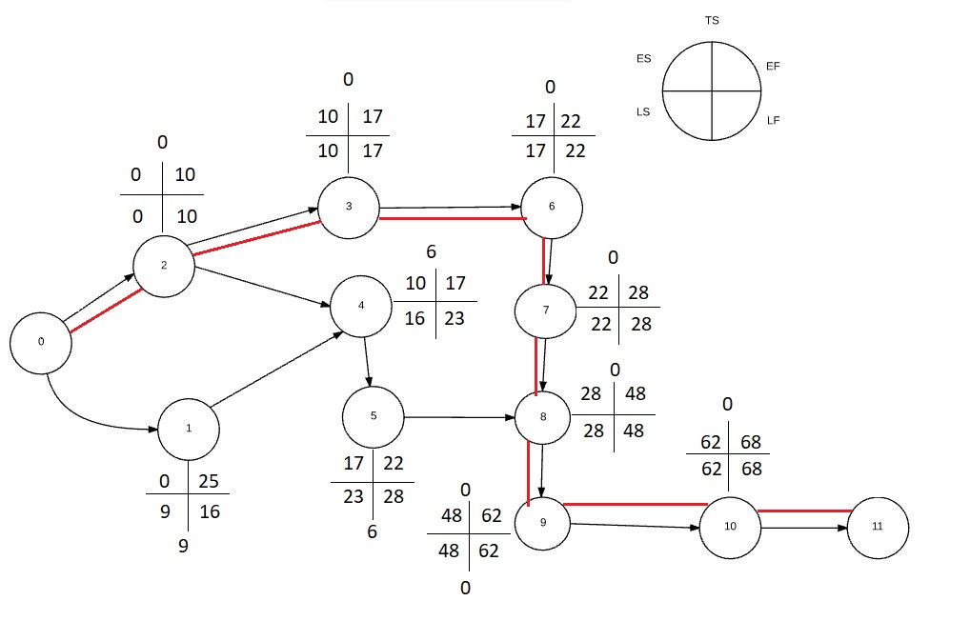
Project Schedule
1.Database
2.Director Page
3.Add Tutor
4.Add student
5.Delete Student
6.Edit tutor
7.Delete tutor
8.Report View
9.Graph View
10.Test Phase

Slide 16
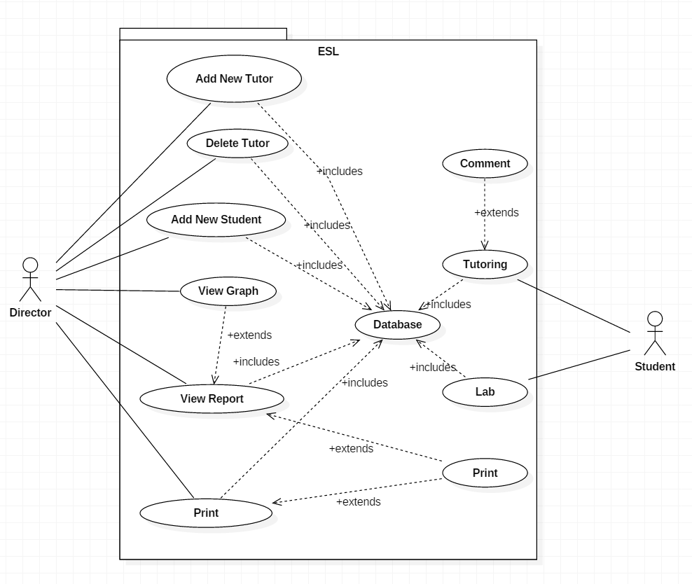
Use Cases Diagram
Notes:
Home case diagram

Slide 17
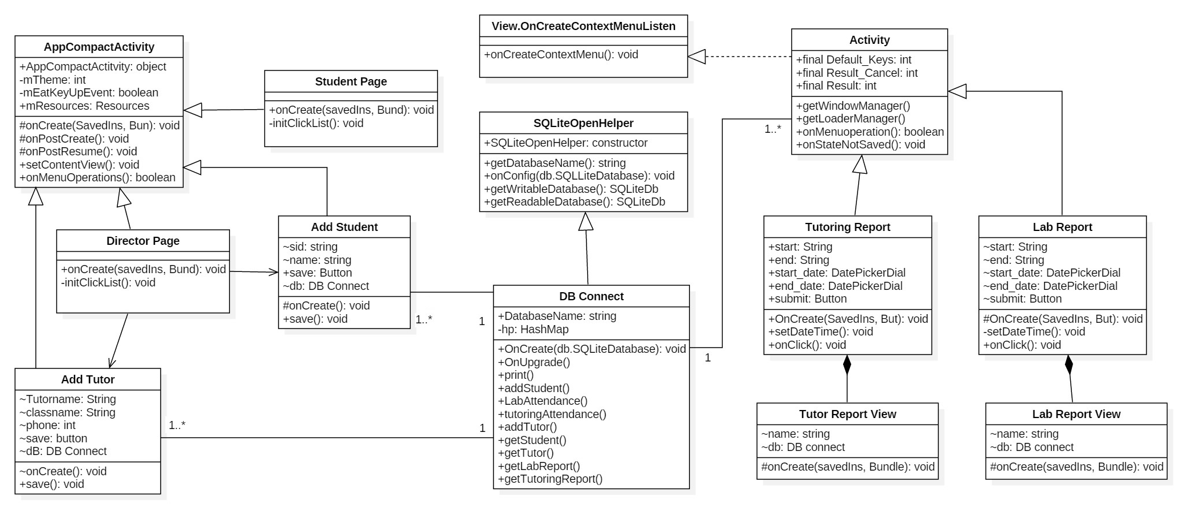
Class Diagram

Slide 18
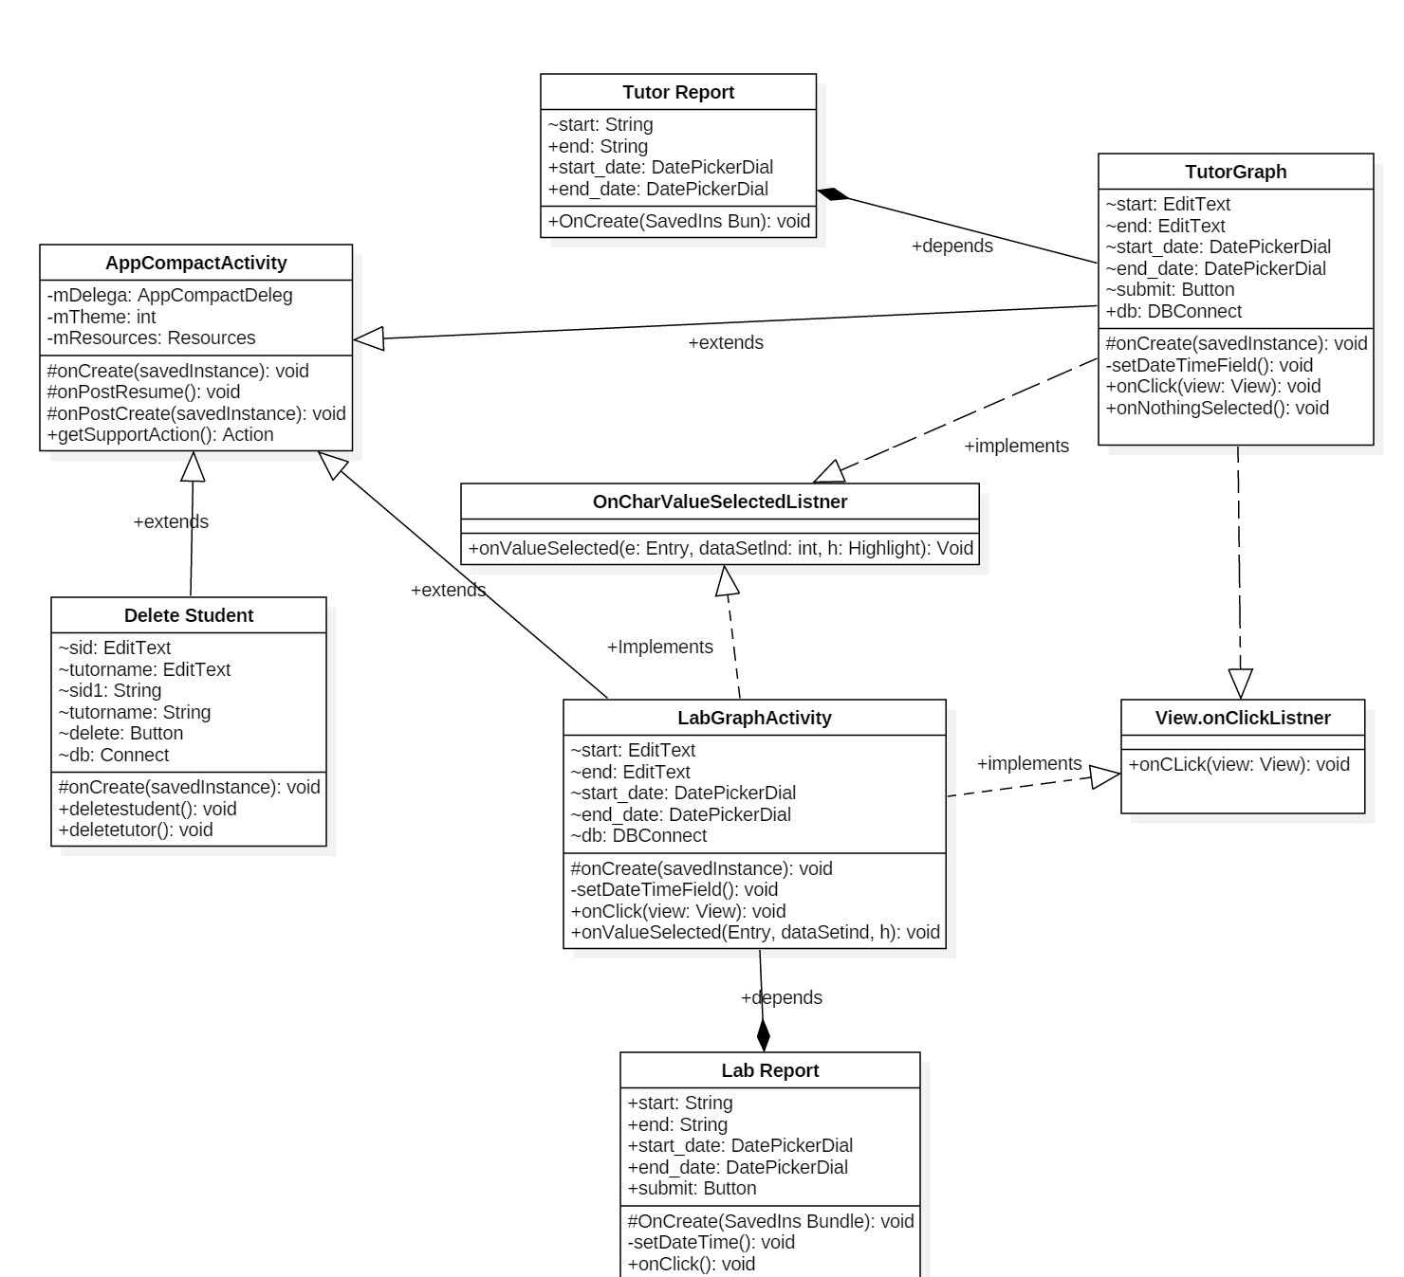
Cont.

Slide 19
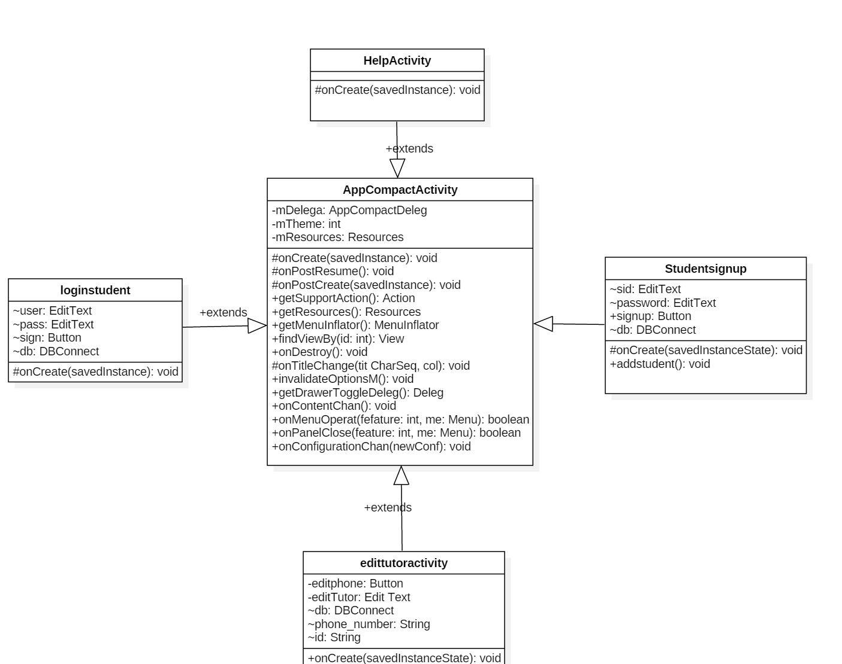
Cont..

Slide 20
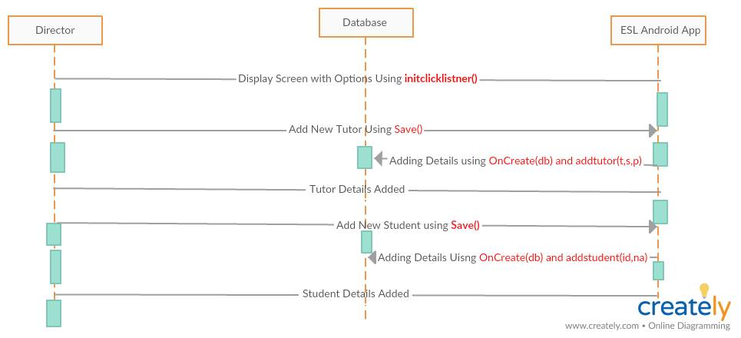
Sequence Diagram
Notes:
Present Object Class diagram identify classes , Send message to object ( kind of class ) How Object connect .
Show between Sequence Diagram and Class diagram must comment

Slide 21
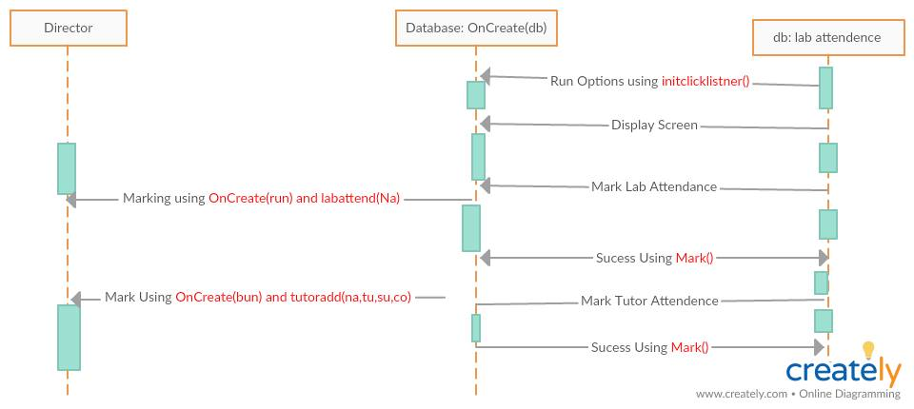
Cont.

Slide 22
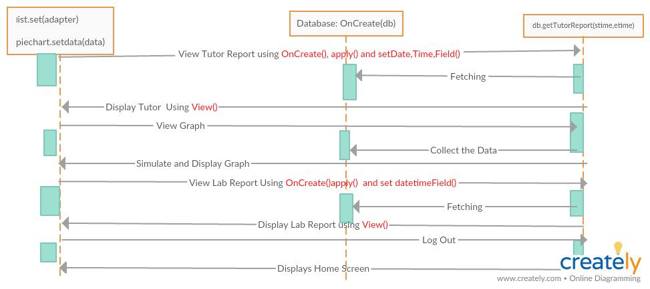
Cont.

Slide 23
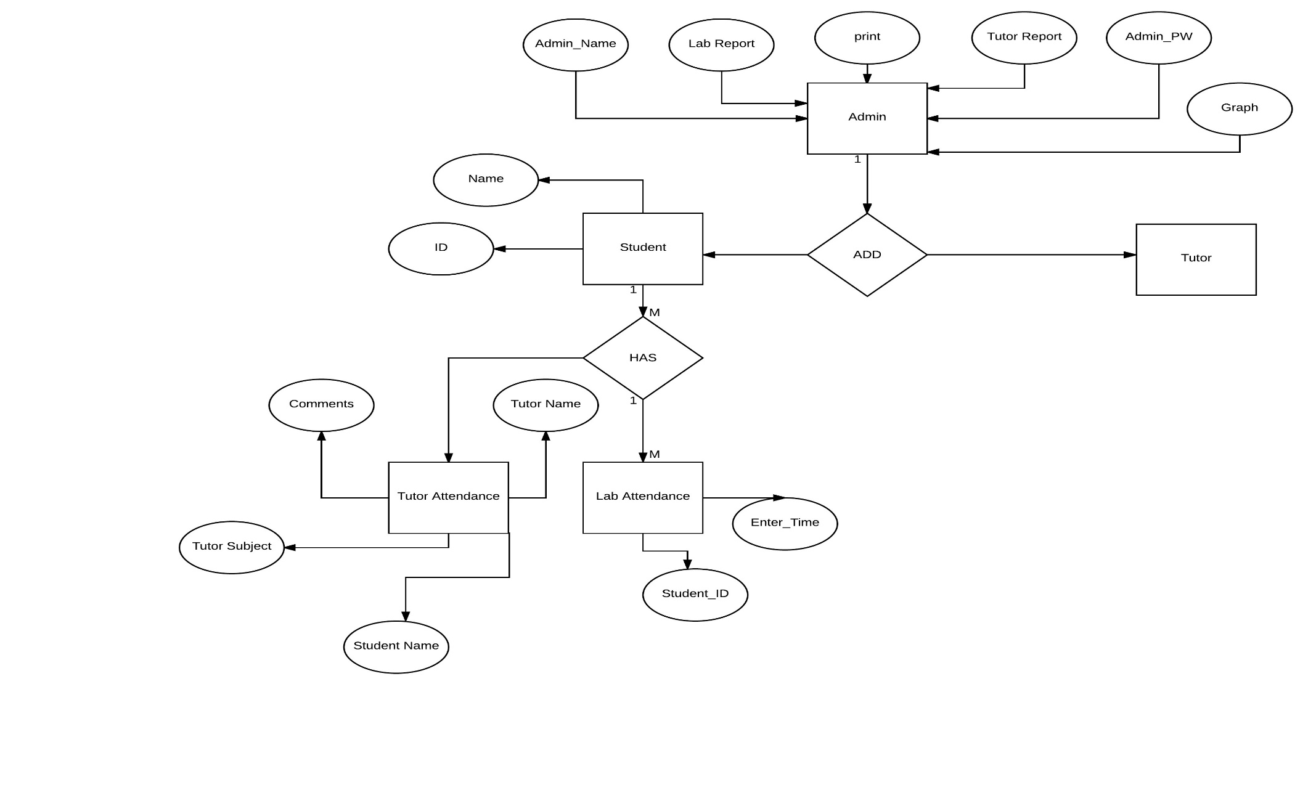
ER Diagram
Notes:
Add code in here

Slide 24
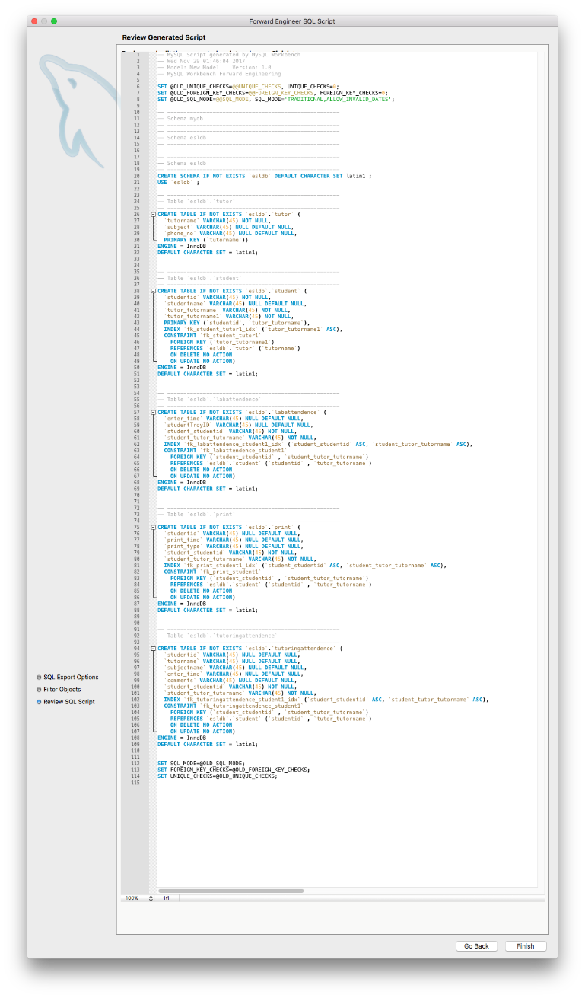
Code

Slide 25
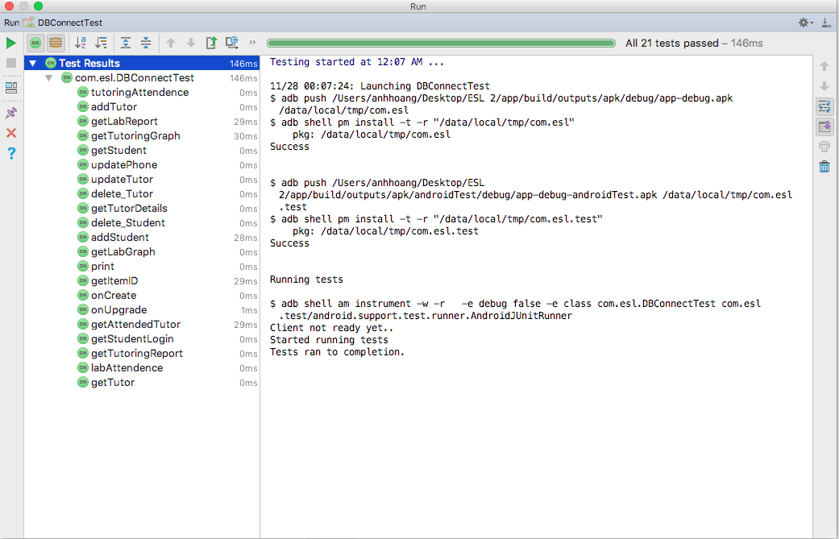
White Box Testing

Slide 26
Cyclomatic Graph

Slide 27
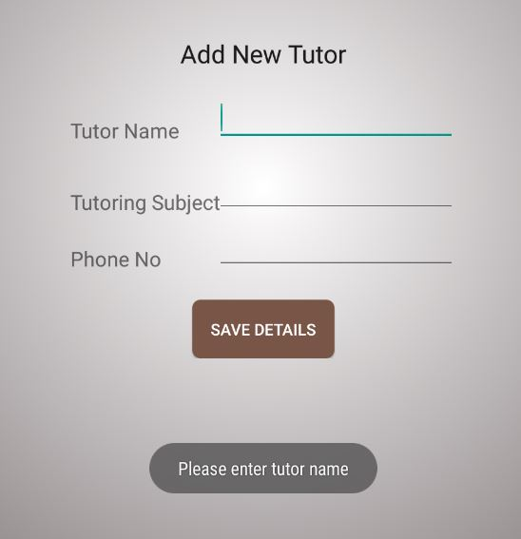
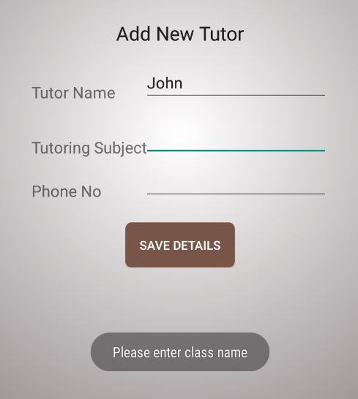
Black Box For Tutor
Test Case | Expected | Outcome | Pass/Fail
When Tutor Name is empty | Please enter Tutor Name | Please enter Tutor Name | Pass
When Subject is empty | Please enter Subject Name | Please enter Subject Name | Pass

Slide 28
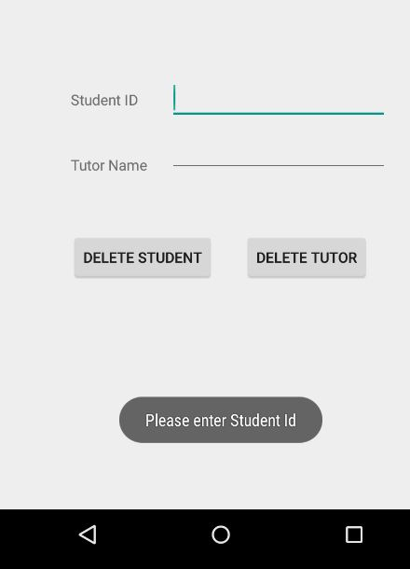
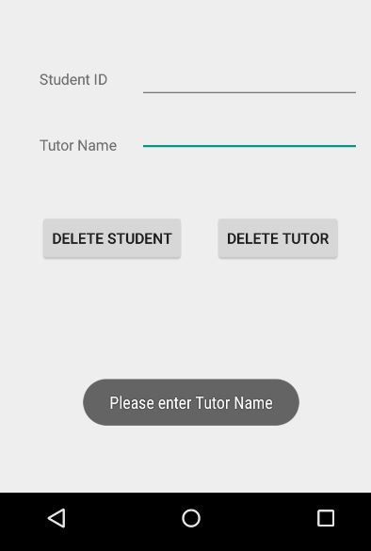
Black Box For Delete User
Test Case | Expected | Outcome | Pass/Fail

Slide 29
Future work
Tutor module
Rating for Students
Appointment with Tutor
Schedule Tutor Appointment

Slide 30
Demo

Slide 31
THANK YOU

